Slide 1
How to run Pipeline in Azure Devops?
Cloud Team
2021.05.27

Slide 2
How to run Pipeline in Azure Devops?
Agenda
Go to specific Devops Project.
Run a specific pipeline for any Micro Service.
Check if 2 steps are done (Pipeline followed by Release).
Check in Azure container Repo (ACR), If the respected pipeline version is present or not.
Cust A
| Cust B |
Cust C

Slide 3
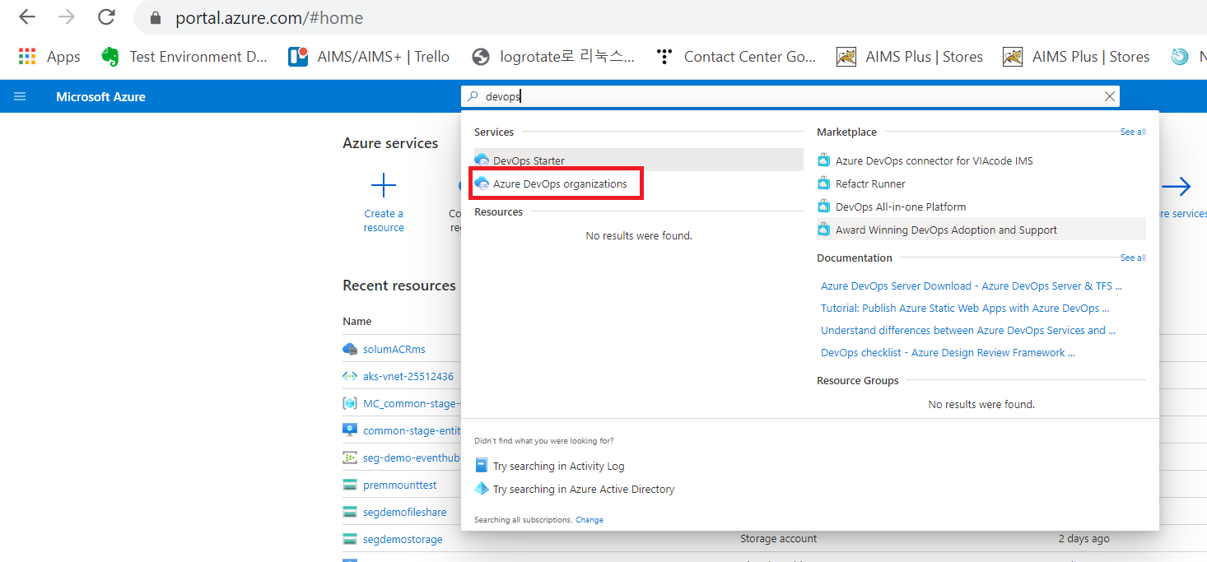
1. Go to specific Devops project.
Please login to azure portal and then switch to Devops.

Slide 4
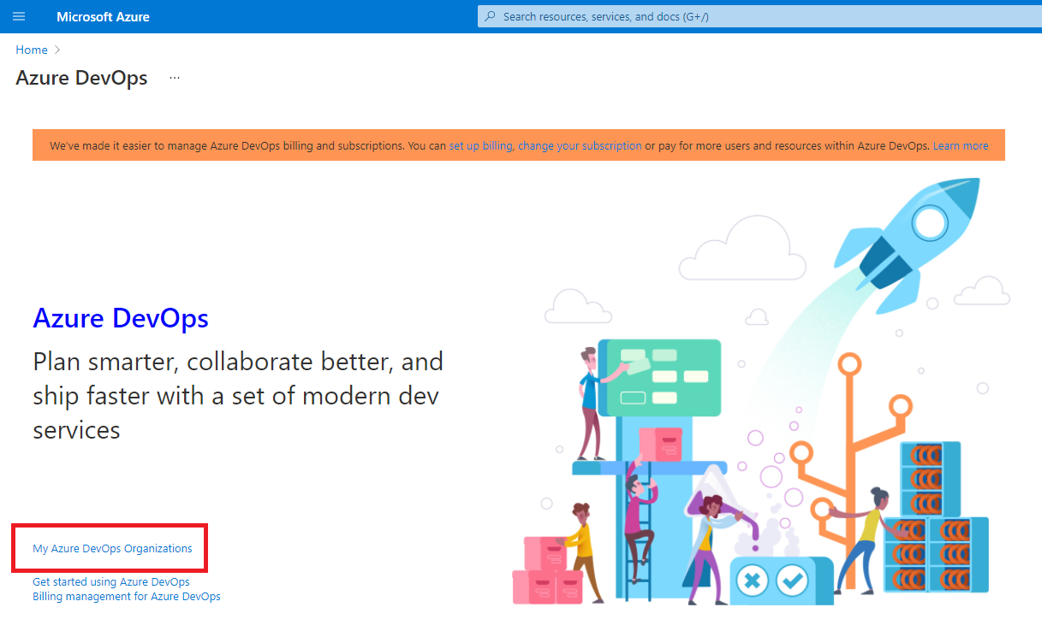
1. Go to specific Devops project.
Choose “My Azure DevOps Organizations”

Slide 5
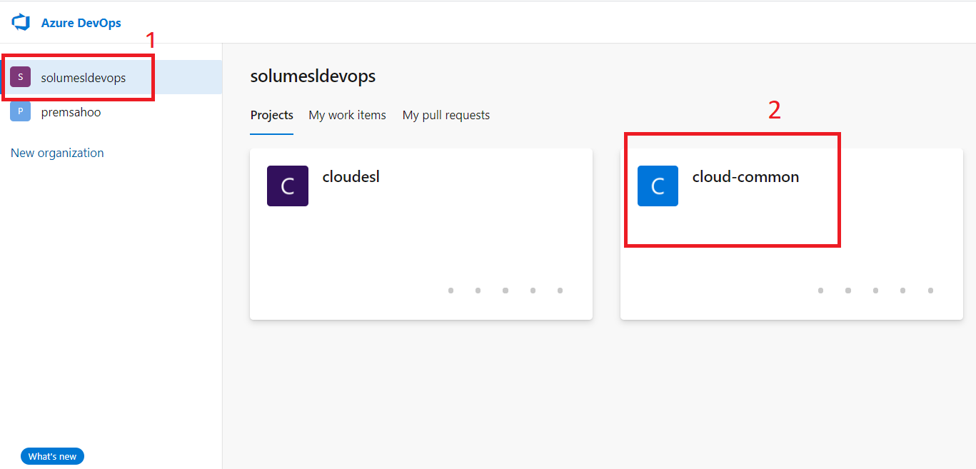
1. Go to specific Devops project.
Select the Organization and choose specific Devops project.

Slide 6
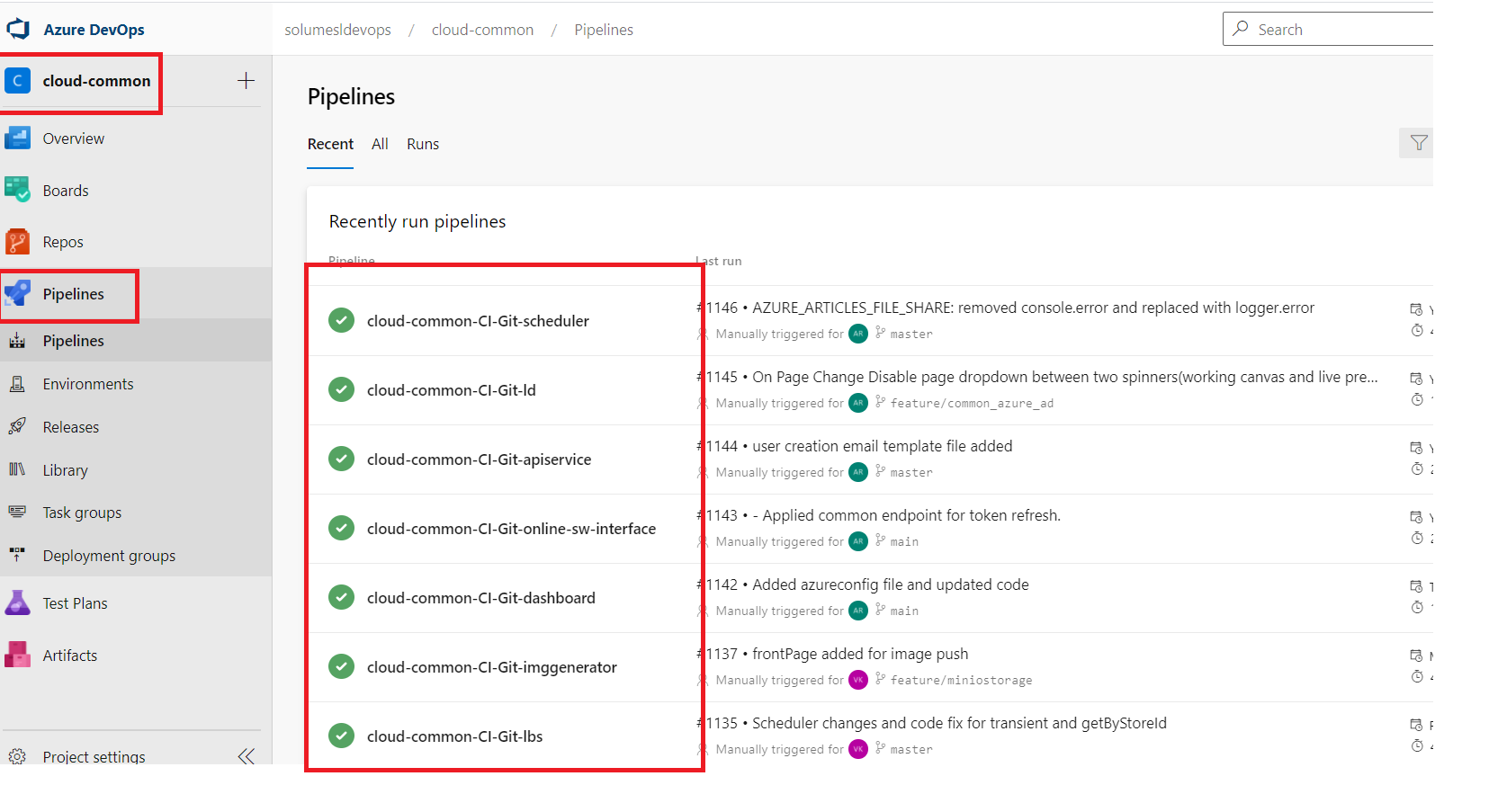
2. Run the specific pipeline for a Micro Service.
Choose a Pipeline to run.

Slide 7
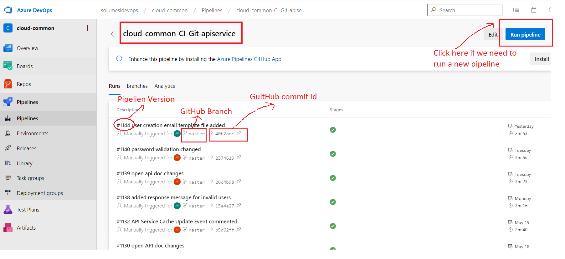
2. Run the specific pipeline for a Micro Service.
Choose a Pipeline to run. (In this example we chose to use Api Service’s pipeline)

Slide 8
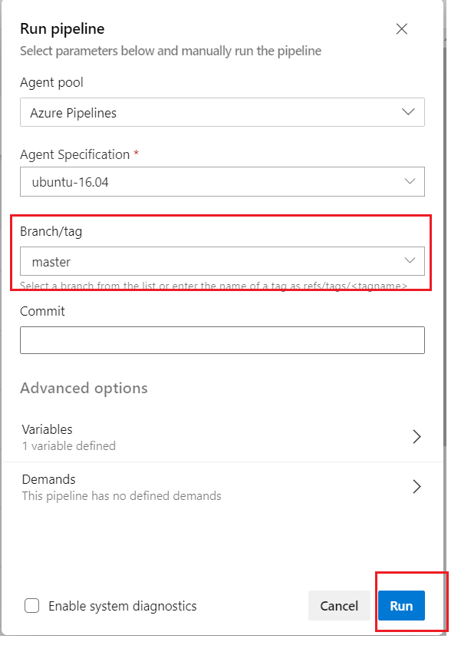
2. Run the specific pipeline for a Micro Service.
If we choose to run a new pipeline for a Micro Service, please follow below snapshot.
As shown in the snapshot, Default branch is mapped with the pipeline already.
If still user opts to run pipeline for different GitHub’s branch, he can select from dropdown.

Slide 9
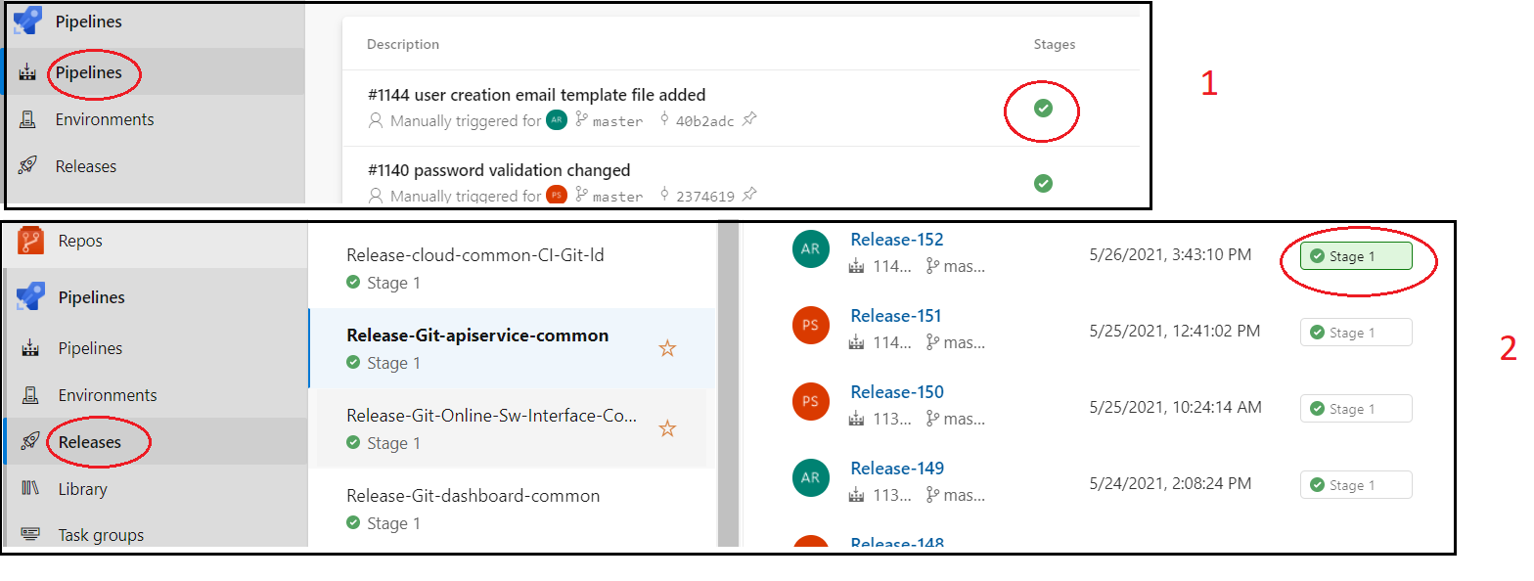
3. Check if 2 steps are done (Pipeline followed by Release)
If the pipeline is successful, it automatically triggers the Release to run for that pipeline within few seconds.
In Release process docker image creation happens and finally if Release is succeeded, specific Docker image will be pushed to ACR (Azure Container Registry)
User can go to ACR in Azure portal and check if the Docker image with same pipeline version is present or not.

Slide 10
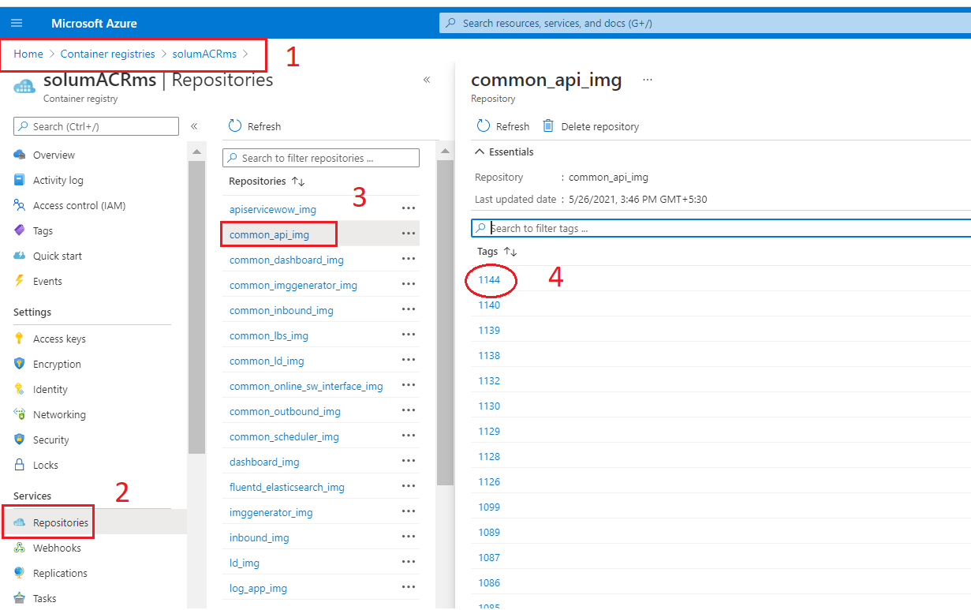
4. Check in Azure container Repo (ACR), If the respected pipeline version is present or not.
User can go to ACR in Azure portal and check if the Docker image with same pipeline version is present or not.

Slide 11

THANK YOU

